Slide 1
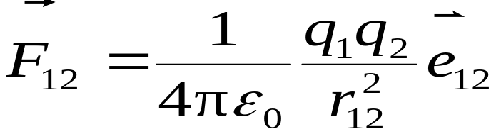
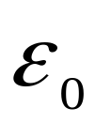
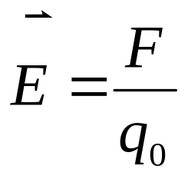
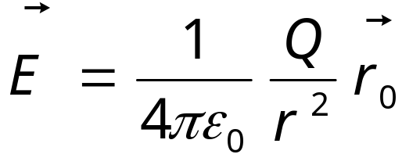
1. Coulomb’s Law
（ :permittivity of free space ）
2. Definition of electric field:
3. Electric Field of A Single Point Charge

Slide 2
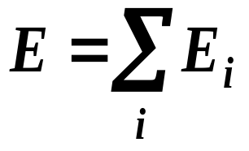
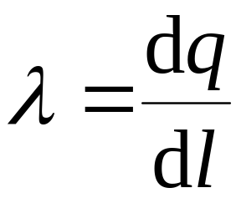
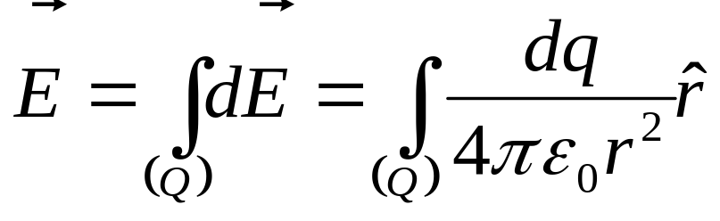
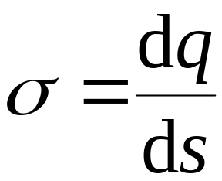
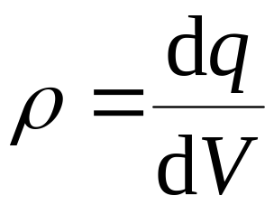
4. Superposition of electric fields
5 Electric Field Calculations for Any Continuous Charged Distributions
电荷线密度
电荷面密度
电荷体密度

Slide 3
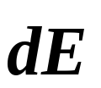


Main Steps of Calculating Electric Field:
Step1:
Choose differential element of charge dq;
Step2:
Calculate set up by the dq ;
Step3:
Build up the coordinate system;
Resolving and find out the scalar integration for .
Step4:
Determine the magnitude and direction of and discuss for its results.
Step5:

Slide 4
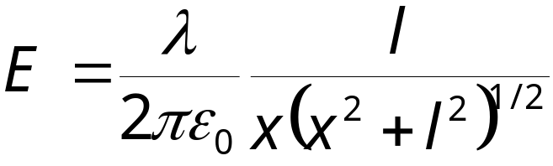
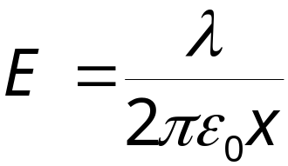
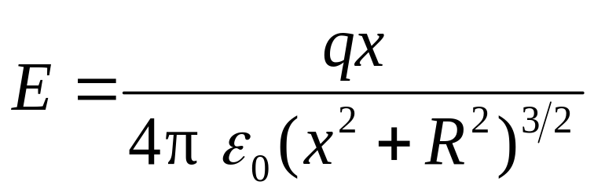
1.Long line of charge
Assume the wire is extremely long in both directions.
2 A ring of charge

Slide 5
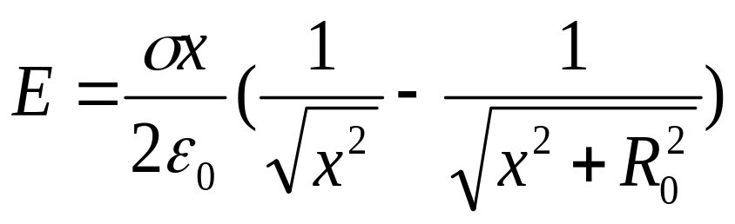
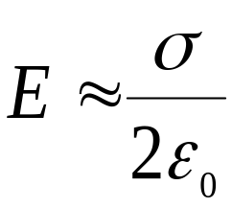
3 Uniformly charged disk
If the radius of the disk is much greater than the distance of point P from the disk (infinite plane)

Slide 6
Chapter 20 Gauss’s Law
A statement of the relationship between electric charge and electric field.
1 Electric Flux（通量）
2 Gauss’s Law
3 Application of Gauss’s Law

Slide 7
New Words and Expressions
flux 通量
Gauss’s Law 高斯定理
gaussion surface 高斯面
spherical 球面的
cylindrical 柱面的
planar 平面的

Slide 8


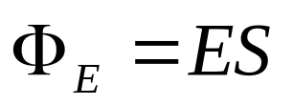

1. Electric Flux (通量) p487-489
1) The cases that planes are in the uniform and the electric field direction is perpendicular to the surface
electric flux —The product of electric field and area of surface.

Slide 9
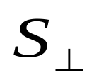





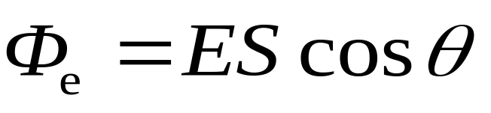
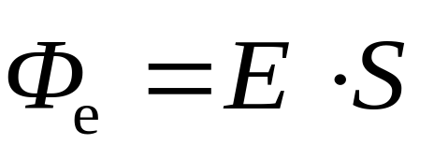
2) The cases that planes are in the uniform but the area S in not perpendicular to
The number of electric field line through both area of S and （the projection of area S）are equal, so
均匀电场 ， 与平面夹角

Slide 10
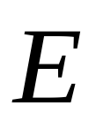
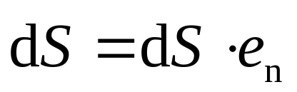
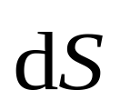

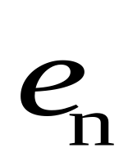
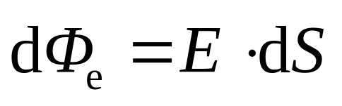
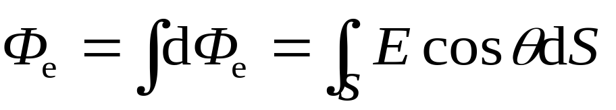
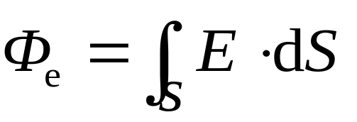
3) For nonuniform fields and curved surfaces we rewrite this definition of electric flux in differential form:
非均匀电场强度电通量
(electric flux through a Gaussian surface)

Slide 11

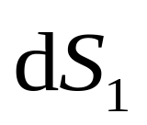


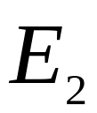


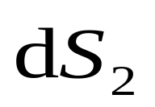
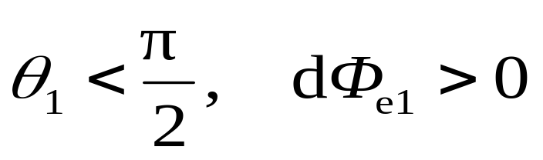
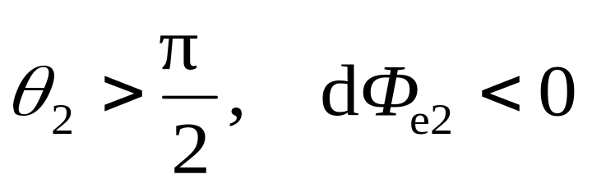
4) For the surfaces which is closed
为封闭曲面
规定：取闭合面外法线方向为正向。We define of S or of dS, to point outward from the enclosed volume.
Flux leaving the volume is positive.
Whereas flux entering the volume is negative.

Slide 12


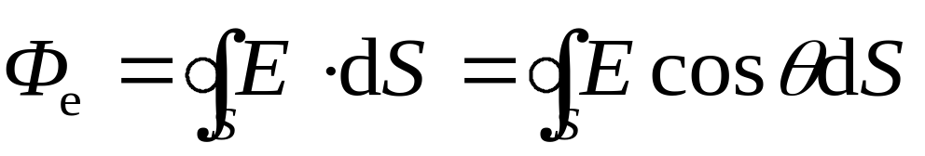

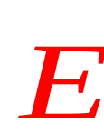
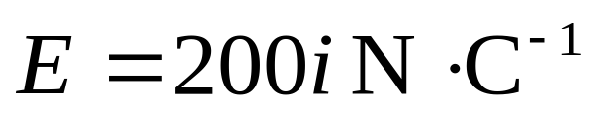


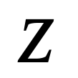
闭合曲面的电场强度通量
例: 如图所示 ，有一个三棱柱体放置在电场强度 的
匀强电场中. 求通过此三棱柱体的电场强度通量 .

Slide 13
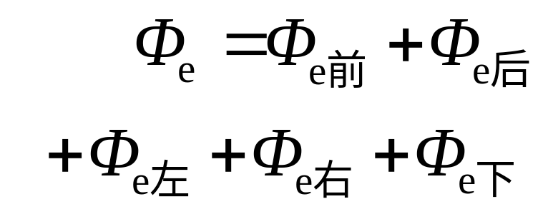

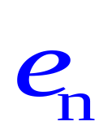
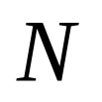

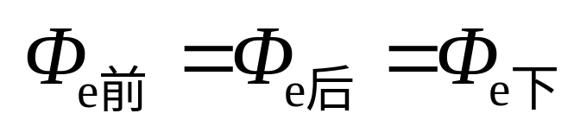

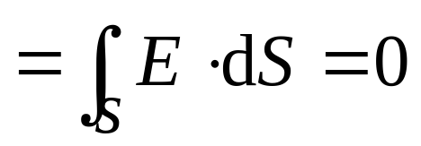


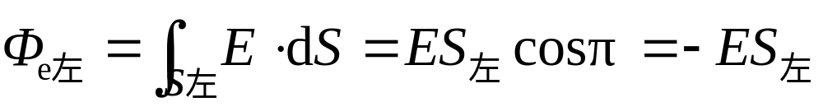
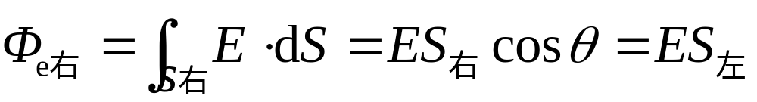
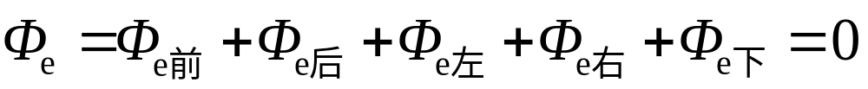
解

Slide 14
2. Gauss’ Law (P489-491)
Karl Friedrich Gauss (1777-1835), German mathematician and physicist. He made a lot of contributions in the fields of experimental physics, theoretical physics and mathematics. He made major contributions to the theory of electromagnetism.

Slide 15
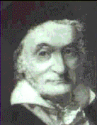
高斯（Carl Friedrich Gauss 1777-1855） 德国数学家和物理学家。1777年4月30日生于德国布伦瑞克，幼时家境贫困，聪敏异常，受一贵族资助才进学校受教育。1795-1799年在哥廷根大学学习，1799年获博士学位。1833年和物理学家W.E.韦伯共同建立地磁观测台，组织磁学学会以联系全世界的地磁台站网。1855年2月23日在哥廷根逝世。
高斯长期从事于数学并将数学应用于物理学、天文学和大地测量学等领域的研究，著述丰富，成就甚多。他一生中共发表323篇（种）著作，提出404项科学创见（发表178项），在各领域的主要成就有：

Slide 16
（1）物理学和地磁学中，关于静电学、温差电和摩擦电的研究、利用绝对单位（长度、质量和时间）法则量度非力学量以及地磁分布的理论研究。
（2）利用几何学知识研究光学系统近轴光线行为和成像，建立高斯光学。
（3）天文学和大地测量学中，如小行星轨道的计算，地球大小和形状的理论研究等。
（4）结合试验数据的测算，发展了概率统计理论和误差理论，发明了最小二乘法，引入高斯误差曲线。此外，在纯数学方面，对数论、代数、几何学的若干基本定理作出严格证明。
在CGS电磁系单位制（emu）中磁感应强度的单位定为高斯（1932年以前曾经用高斯作为磁场强度单位），便是为了纪念高斯在电磁学上的卓越贡献。

Slide 17
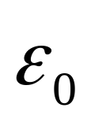
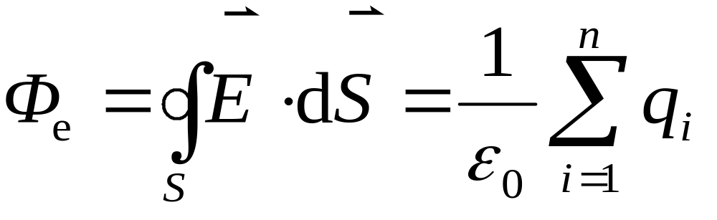
1) Gauss’law for vacuum.
定理：在真空中,通过任一闭合曲面的电场强度通量,等于该曲面所包围的所有电荷的代数和除以 .
（与面外电荷无关，闭合曲面称为高斯面）
ε₀: permittivity of free space
The flux of the electric field through a closed surface of any shape equals to 1/ε₀ times of the algebraic（代数） sum of charges enclosed within the surface.

Slide 18
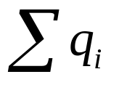
Discussion
1) The relation of the source of electric filed and the field.
反映场和源 的关系。
2) Where is the algebraic sum of all charges enclosed in the Gaussian surface. Φ is not related to the way of distribution and outside charges.
电通量只与面内电荷有关，与面外电荷无关。

Slide 19

3) The quantity on the left side of above equation is the electric field resulting from all charges, both those inside and those outside the Gaussian surface.
为高斯面上某点的场强，是由空间所有电荷产生的，与面内面外电荷都有关。
4) Gauss’s Law and Coulomb’s law are equivalent (See P496). However, Gauss’s Law is hold for the produced by moving charges; Coulomb’s law is only true for electrostatic field.
5) It give a simple way to calculate the distribution of electric field for a given charge distribution with sufficient symmetry.

Slide 20
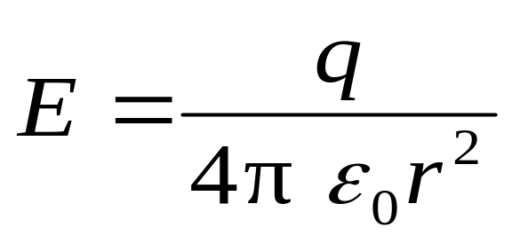
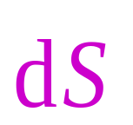

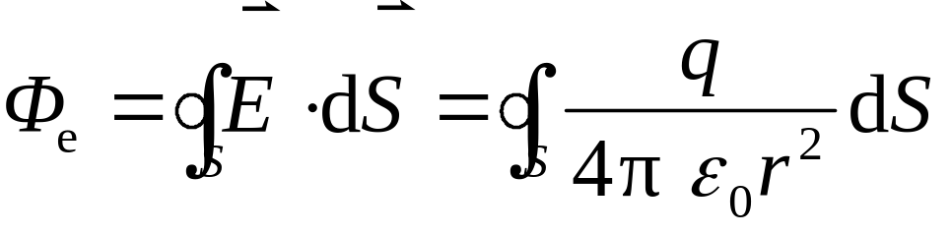

2) The derivation of Gauss’s Law(高斯定理的导出)
库仑定律
高斯
定理
电场强度叠加原理
点电荷位于球面中心 (a spherical surface enclosing a point charge at its center)
+

Slide 21




点电荷在任意封闭曲面内 (with irregular surface)
The same number of field lines pass through surface , as pass through the spherical surface .
+

Slide 22










点电荷在封闭曲面之外

Slide 23












由多个点电荷产生的电场

Slide 24

高斯定理
总 结
1）高斯面上的电场强度为所有内外电荷的总电场强度.
2）高斯面为封闭曲面.
3）穿进高斯面的电场强度通量为正，穿出为负.
4）仅高斯面内的电荷对高斯面的电场强度通量有贡献.
5）静电场是有源场.
第三次课结束

Slide 25
REVIEW(P26-29)

Slide 26

1. Electric Flux (通量) p487-489
1) For nonuniform fields and curved surfaces the definition of electric flux in differential form:
非均匀电场强度电通量

Slide 27
For the surfaces which is closed (Gaussian surface)
为封闭曲面
规定：取闭合面外法线方向为正向。We define of S or of dS, to point outward from the enclosed volume.
Flux leaving the volume is positive.
Whereas flux entering the volume is negative.

Slide 28
闭合曲面的电场强度通量
electric flux through a Gaussian surface

Slide 29
2. Gauss’ Law (P489-491)
定理：在真空中,通过任一闭合曲面的电场强度通量,等于该曲面所包围的所有电荷的代数和除以 .
（与面外电荷无关，闭合曲面称为高斯面）
ε₀: permittivity of free space（介电常数）
The flux of the electric field through a closed surface of any shape equals to 1/ε₀ times of the algebraic sum of charges enclosed within the surface.

Slide 30
The relation of the source of electric filed and the field .
高斯定理反映场和源 的关系.
2) Where is the algebraic sum of all interior charges enclosed in the Gaussian surface. Φ is not related to the way of distribution and outside charges.
电通量只与面内电荷有关，与面外电荷无关。

Slide 31
3) The quantity on the left side of above equation is the electric field resulting from all charges, both those inside and those outside the Gaussian surface.
为高斯面上某点的场强，是由空间所有电荷产生的，与面内面外电荷都有关。
4) It gives a simple way to calculate the distribution of electric field for a given charge distribution with sufficient symmetry.

Slide 32

3 Applying Gauss’ Law (p491-495)
a.场对称性分析。
Identify the symmetry of the charge distribution.
b.选取高斯面。
Draw the appropriate gaussion surface. (spherical, cylindrical, planar)
c.计算电通量。
Evaluate the flux with gaussion surface.
d.确定面内电荷代数和 。
Calculate the charge enclosed by gaussion surface.
e.应用定理列方程求解。
Determine electric field using Gauss’s law.

Slide 33






高斯面选取的原则
a.要求电场具有高度对称性。
b.高斯面要经过所研究的场点。
c.高斯面应选取规则形状。
d.面上各点的场强大小相等，方向与高斯面法线方向一致。
写成
e.高斯面上某一部分各点的场强方向与高斯面法线方向垂直，该部分的通量为0。

Slide 34




spherical symmetry
Spherical shell of uniform charge
A thin spherical shell of radius R possesses a total net charge Q that is uniformly distributed on it.
Determine the electric field at point (a) outside the shell, and (b) inside the shell.
+
+
+
+
+
+
+
一半径为 , 均匀带电 的薄球壳 . 求球壳内外任意点的电场强 度.
+
+
+
+
+

Slide 35




Solution:
Because the charge is distributed symmetrically, the electric field must also be symmetric. Thus the field must be directed radially outward or inward.
We choose our imaginary gaussian surface to be a sphere of radius r concentric with the shell as a dashed circle the shell.
+
+
+
+
+
+
+
+
+
+
+
+

Slide 36







（a）
+
+
+
+
+
+
+
+
+
+
+
（b）
+
+
+
+
+
+
+
+
+
+
+
+
+

Slide 37




讨论
1、均匀带电球面内部的场强处处为零。
2、均匀带电球面外面的场强分布正象球面上的电荷都集中在球心时所形成的一个点电荷在该区的场强分布一样。
3、场强随距离的变化曲线------E-r曲线如图。

Slide 38
2. Solid sphere of charge. An electric q is distributed uniformly throughout a nonconducting sphere of radius R. Determine the electric field (a) outside the sphere and inside the sphere.
半径 R、带电量为 q 的均匀带电球体，计算球体内、外的电场强度。
+
+
+
+
+
+
+
+
+
+
+
+
+
+
+
+
+
+
+

Slide 39





(a). 球体外部 r > R
作半径为 r 的球面；
+
+
+
+
+
+
面内电荷代数和为
+
+
+
+
+
+
球面上各点的场强 E 大小相等，方向与法线同向。
+
+
+
+
+
+
+
与点电荷的场相同。

Slide 40


(b). 球体内部 r < R
作半径为 r 的球面；
+
+
面内电荷代数和为
+
+
+
+
+
+
+
+
+
+
+
+
+
+
+
+
+
球面上各点的场强 E 大小相等，方向与法线相同。

Slide 41











Slide 42




cylindrical symmetry（柱对称）
Long uniform line of charge. A very long straight wire possesses a uniform positive charge per unit length .
Calculate the electric field at a distance r from the axis of the rod.
+
+
+
+
+
无限长均匀带电直线，单位长度上的电荷，即电荷线密度为 ，求距直线为 处的电场强度.

Slide 43




Our Gaussian surface should match the symmetry of the problem—axis symmetry (轴对称性) or cylindrical symmetry.
+
+
+
+
+
+
场强沿垂直轴线的方向；距中心同远处场强相同.
From symmetry, the direction of is radially outward from the line of charge if the charge is positive; the magnitudes of at the same r are same.

Slide 44







+
+
+
+
+
+
第四次课结束

Slide 45

Planar symmetry（面对称）
Infinite plane of charge. Charge is distributed uniformly, with a surface charge density σ , over a very large but very thin nonconducting flat plane surface. Determine the electric field at points near the plane.
+ + + + + + + + + +
无限大均匀带电平面，单位面积上的电荷，即电荷面密度为 ，求距平面为 处的电场强度.
+ + + + + + + + + +
+ + + + + + + + + +
+ + + + + + + + + +
+ + + + + + + + + +
+ + + + + + + + + +

Slide 46







Planar Symmetry—— 垂直板面向外, 距板同远处E大小相同.
Choose the gaussian surface a small, closed cylinder whose axis is perpendicular to the plane.
选取闭合的柱形高斯面
+ + + + + + + + + +
+ + + + + + + + + +
+ + + + + + + + + +
+ + + + + + + + + +
底面积
+ + + + + + + + + +
+ + + + + + + + + +
+ + + + + + + + + +
+ + + + + + + + + +
+ + + + + + + + + +
+ + + + + + + + + +
+ + + + + + + + + +
+ + + + + + + + + +

Slide 47










Slide 48



Discussion:
If we arrange two infinite plates, with uniform opposite σ, to be close to each other and parallel as the figure shown. What are the in the region of A, B and C?
A
B
C
The electric field between parallel-plate capacitor in circuit (直流电路中的平行板电容器间的场强) is such a case.

Slide 49





讨 论
无限大带电平面
的电场叠加问题

Slide 50
Summary:
For certain symmetry arrangements of charge (as illustrated cylindrical, planar and Spherical symmetry), G.L. is very much easier to use than integration of field components.
The key factors of choosing G. surface:
The magnitude of E at the surface is constant; and the Gaussian surface should pass through the question-point .

Slide 51
Main Steps by using Gauss (G.) Law:
Step1:
Analysis of symmetry;
Step2:
Choose a suitable G. surface;
Step3:
Calculating by G. law;

Slide 52


Conductor p494-495
Conductor:There exist a lot of free moved charges.
Insulator (绝缘体): Almost no free moved charges.
Semiconductor(半导体): Between them.
1. Interaction between Electrostatic Field and Conductor:
A conductor in uniformly electric field :

Slide 53


Electrostatic Field
导体
Free charges Redistributing
静电感应
(electrostatic induction)
Electrostatic Equilibrium (静电平衡状态):导体内部和表面都没有电荷的宏观移动.
-
-
+
+
-
+
-
-
+
+
-
+
-
E=0
+
-
+
-
+

Slide 54




2. Distribution of Charges on Conductor under The Electrostatic Equilibrium (P495)
1
Charges placed on an isolated conductor will move entirely to the surface of the conductor. None of the excess charge will be found within the conductor (导体内净电荷为零).
Choose an arbitrary G.S. in the internal conductor. From Gauss’ Law,
S
P

Slide 55




—— there is no net charge in any small volume of internal conductor
静电平衡时导体内无净电荷，所有电荷分布于外表面。
面内电荷是否会等量异号？
高斯面
缩小高斯面。
与静电平衡条件矛盾。
所以静电平衡时导体内无净电荷。

Slide 56






2
The magnitude of the at a location just outside a conductor (导体外表面)is proportional to surface charge density at that location on the conductor.
证明：垂直导体表面作一小高斯柱面，外底面上的场强近似不变。
作钱币形高斯面 S
+
+
+
+
+
+
+
+
+
+
+

Slide 57













外底面上电场大小相等，

Slide 58
E: produced by all charged bodies in the space.
σ: related to all charge distribution in the space.

Slide 59



3
An Isolated Conductor with a Cavity (P495):
(a) There is no net charge on the inside the cavity walls if no charges inside the cavity
空腔内表面无电荷全部电荷分布于外表面。
证明：在导体内作高斯面，
导体内

Slide 60
面内电荷是否会等量异号？
如在内表面存在等量异号电荷，则腔内有电力线，移动电荷作功。所以导体不是等势体，与静电平衡条件矛盾。
所以内表面无电荷，所有电荷分布于外表面。

Slide 61




(b) If there is charge +q in the cavity, then it induces –q at inner surface and all excess charge remains on the outer surface of the conductor.
空腔原带有电荷 Q ，将 q 电荷放入空腔内。
内表面带有 –q 电电荷。
外表面带有 Q+q 电荷。
证明：在导体面内表面作高斯面，

Slide 62


导体内
由于腔内有 q 电荷，
腔内表面有 –q 电荷,
由电荷守恒定律，在外表面上产生等量的正电荷，外表面上的电荷为：

Slide 63



腔内电荷变化会引起腔外电场的变化。
接地可屏蔽内部电场变化对外部的电场影响。
例如：如家电的接地保护； 半导体中的中周外壳是金属的。

Slide 64




4
The surface charge density outside the surface of a conductor is related to the radius at that location on the conductor (导体外表面的电荷密度与该处曲率半径有关).
Far away from each other
r₂
r₁

Slide 65

导体表面尖锐处 R小，σ 大，表面E也大；
导体表面平滑处 R大，σ 小，表面E也小；
带来一个现象--尖端放电
在带电尖端附近，电离的分子与周围分子碰撞，使周围的分子处于激发态发光而产生电晕现象。

Slide 66

尖端放电现象的利与弊
例如避雷针。避雷针就是利用其尖端的电场强度大，空气被电离，形成放电通道，使云地间电流通过导线流入地下而避免“雷击”的。
尖端放电会损耗电能，还会干扰精密测量和对通讯产生危害。

Slide 67
< 电风实验 >
+
+
+
+
+
+
+
+
+
+

Slide 68


Example: Two parallel-conducting-plates with same area (S>>d²). They charged Q_{A} and Q_{B} respectively. Find the surface density at each face of the plates under electrostatic equilibrium.

Slide 69











Solution:
Assume surface density is σ
From conservation of charges law,
Considering the point P_{B} in plate B, 由静电平衡条件：

Slide 70




1.两外表面电荷等量同号。
2.两内表面电荷等量异号。

Slide 71







讨论：
①
有
②

Slide 72














Another solution:
Plot a Gauss’s surface S', we have
S
P_{B}
S'
d
Think that if the plate B is connected to the ground, then…
σ₁= σ₄ = 0.

Slide 73
Homework 5:
p498: 4; 6; 8; 15; 18;
21; 22; 27; 29; 36.
第五次课结束

